Slide 1
Software Analysis and Design CSE 460 (Observer Design Pattern)
H.S. Sarjoughian
Computer Science & Engineering Dept.
School of Computing, Informatics, and Decision Systems Engineering
Ira A. Fulton School of Engineering
Arizona State University, Tempe, AZ, USA

Slide 2
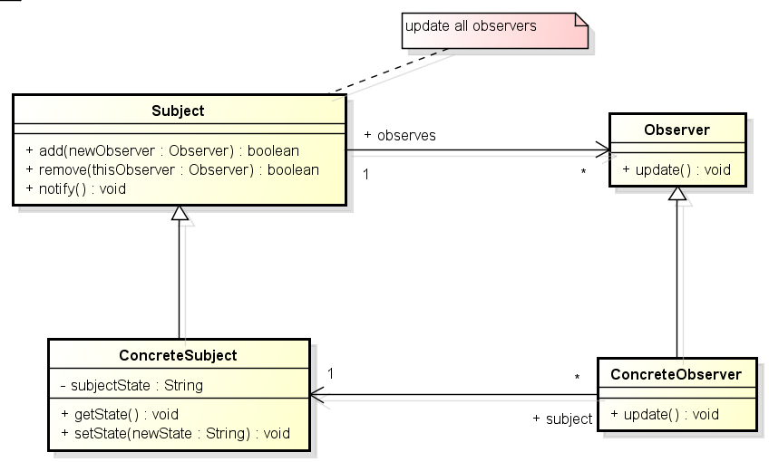
Observer Design Pattern - GoF
This class diagram specifies the participants of the Observer Design Pattern with their relationships. Consistency among the Subject and the Observer classifiers is defined which in turn drive consistency among ConcreteSubject and Concrete Observer classifiers.

Slide 3
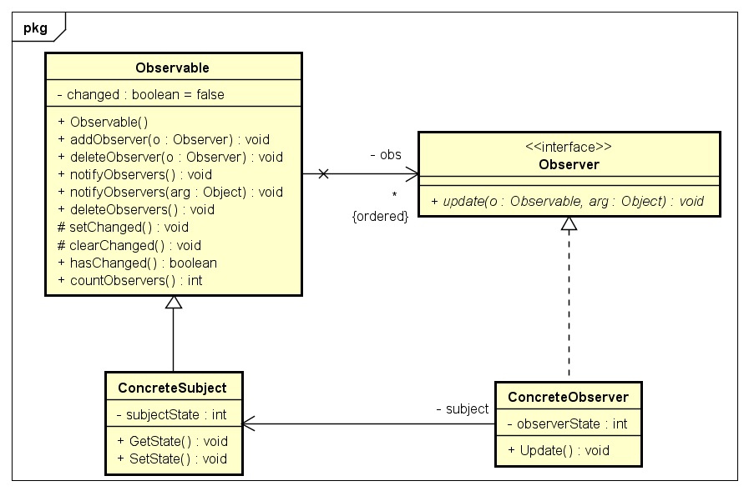
Observer Design Pattern – GoF / Java
This class diagram specifies the Observer Design pattern using Java (JDK 10). The Observer classifier is defined as an interface.

Slide 4
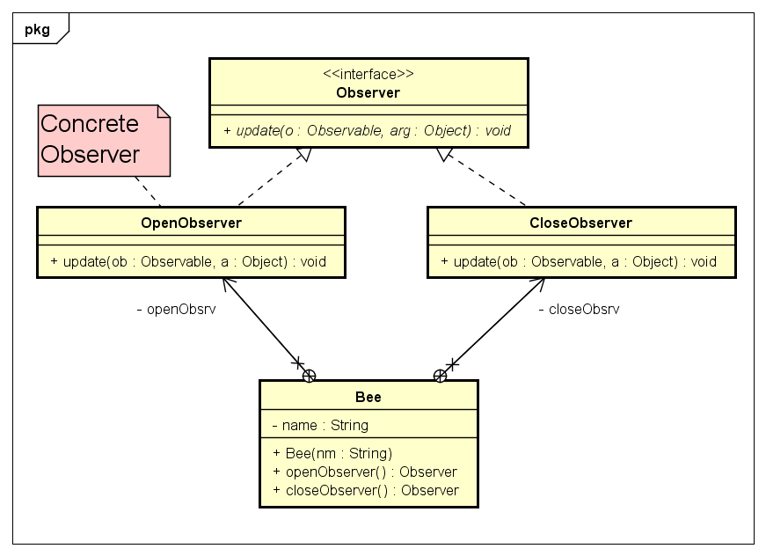
Observer - Bee
This class diagram specifies the class Bee where its inner classes implement the Observer update operation.

Slide 5
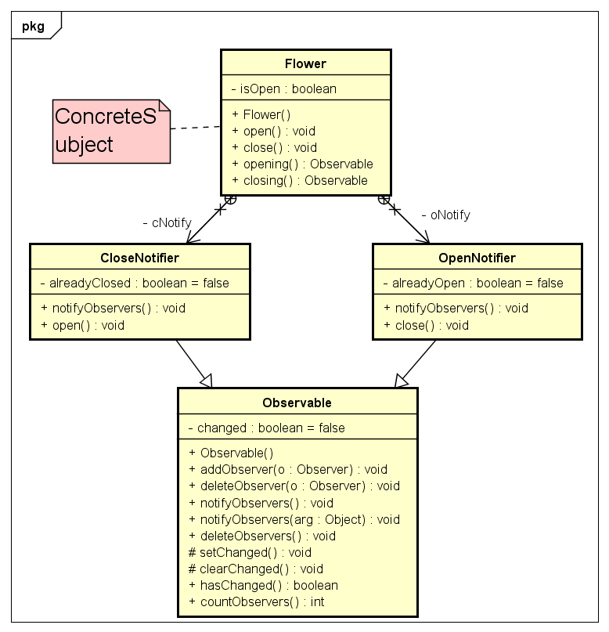
Subject (Observable) - Flower
This class diagram specifies the class Flower with two inner classes, each allowing observers to be added to them.

Slide 6
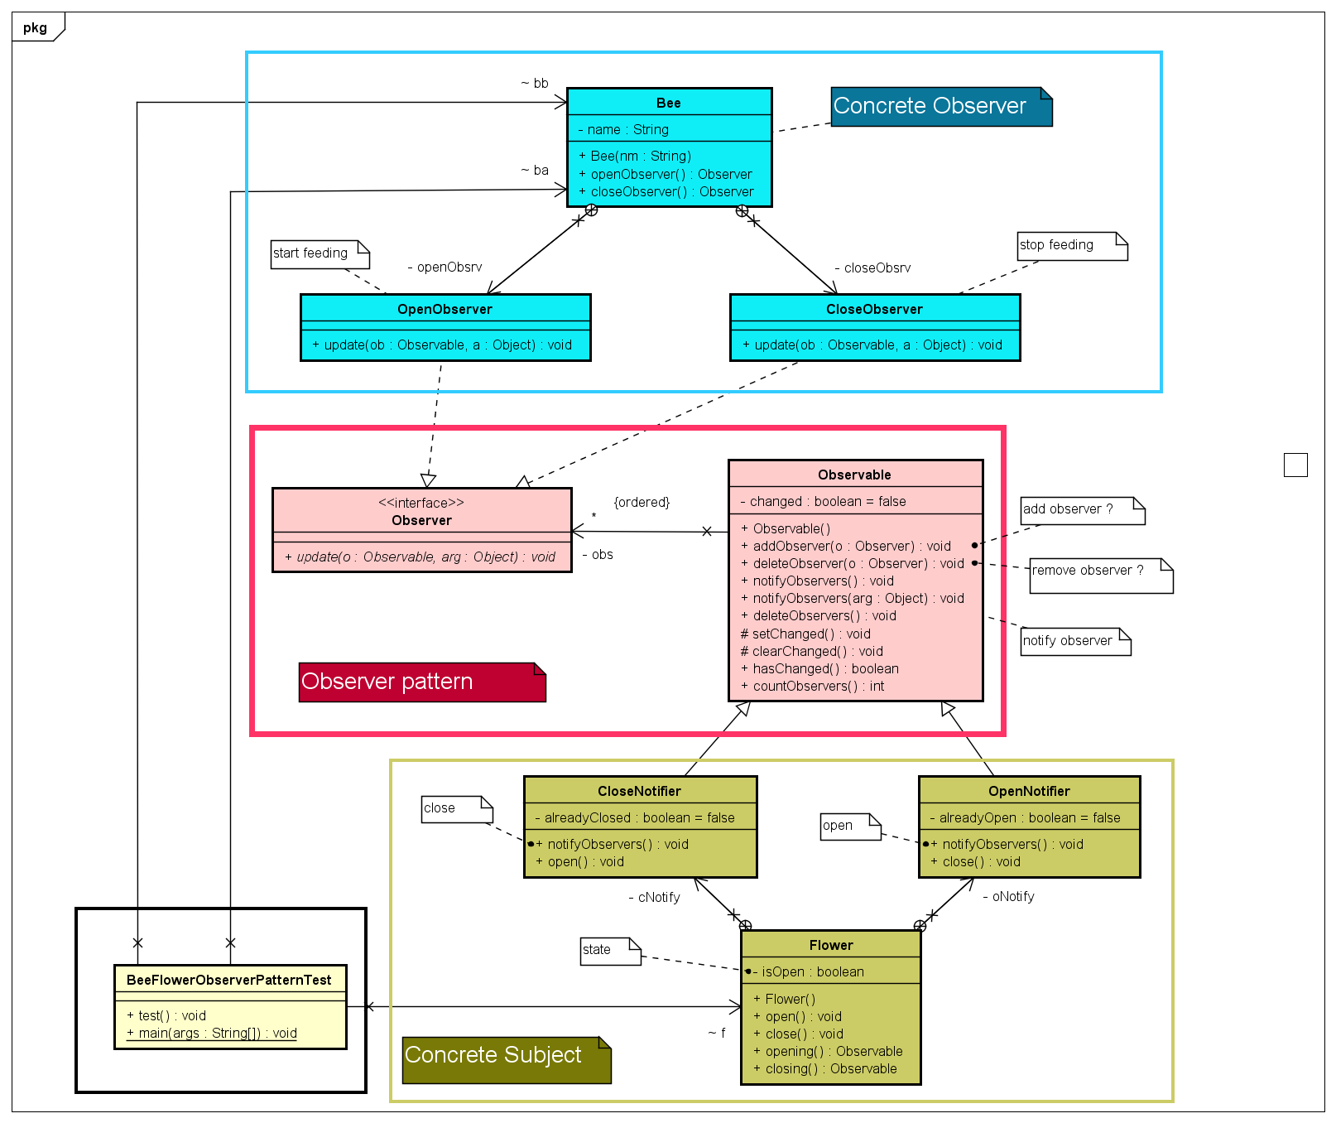
Flower-Bee Observer-Pattern Example

Slide 7
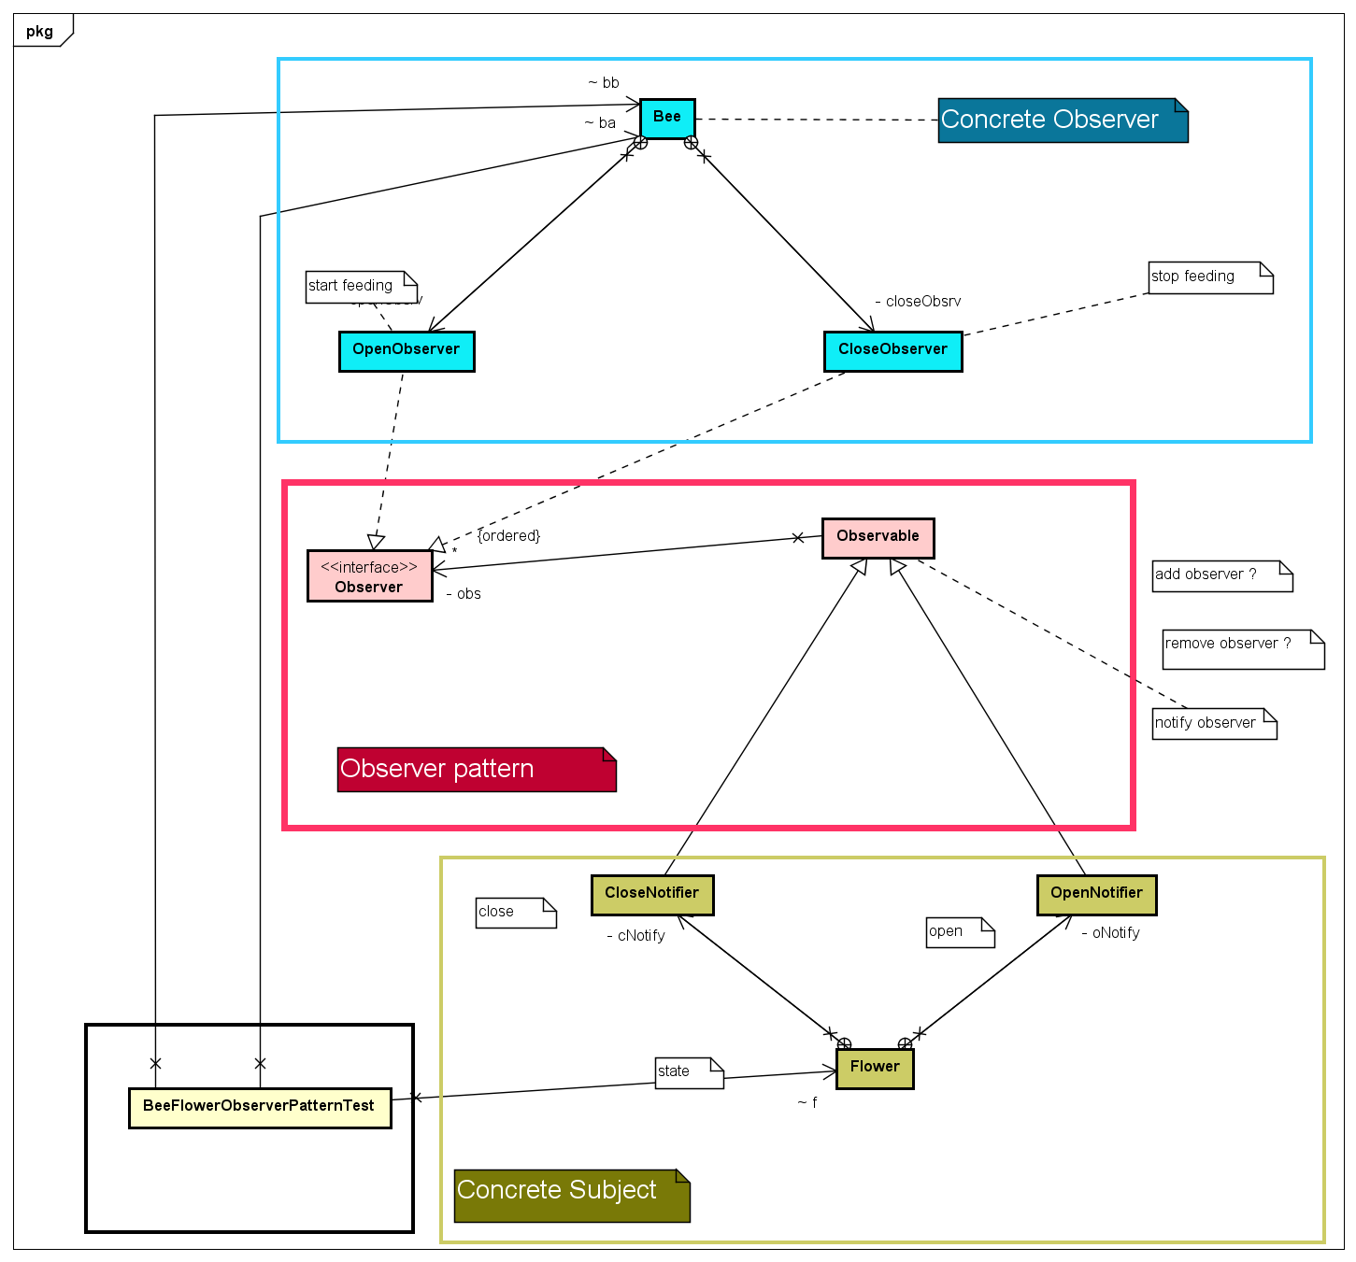
Flower-Bee Observer-Pattern Example –simple classifier notation

